Slide 1
Media query
Eng:Saeed Ramadan

Slide 2
Agenda
Media Query Syntax
Media Types
Media features
Operators (and , or , not)
Small Example

Slide 3
Media Query Syntax

Slide 4
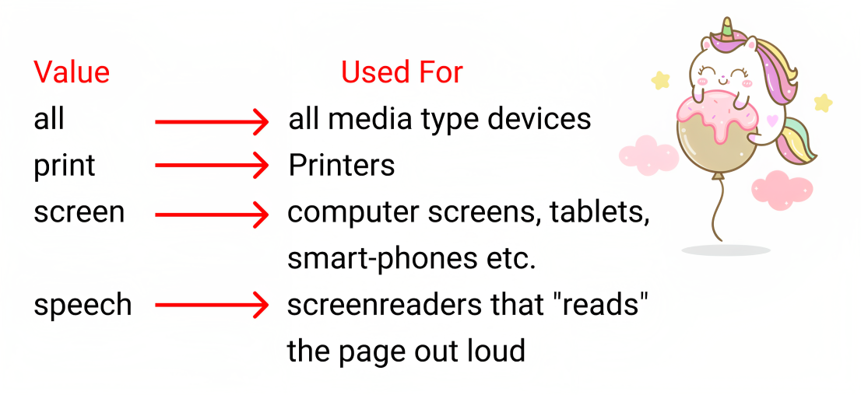
Media Types

Slide 5
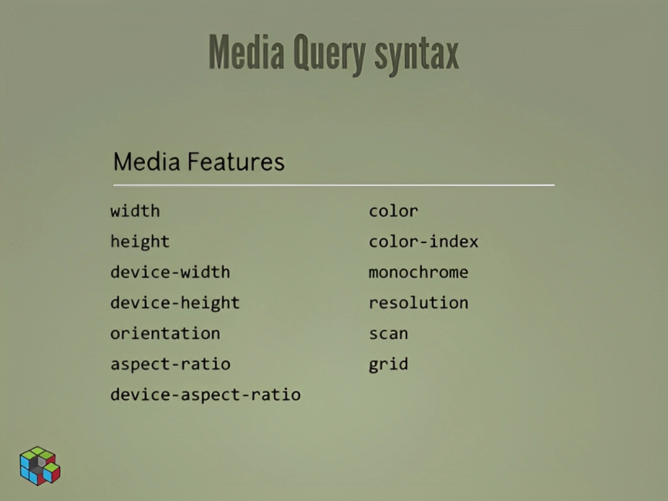
Media features

Slide 6
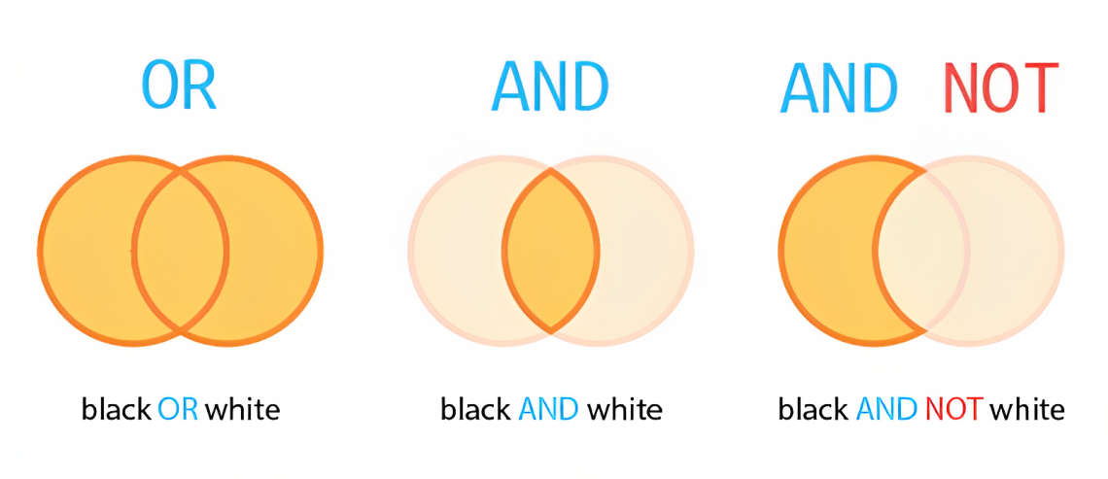
Operators (and , or , not)

Slide 7
Small Example

Slide 8
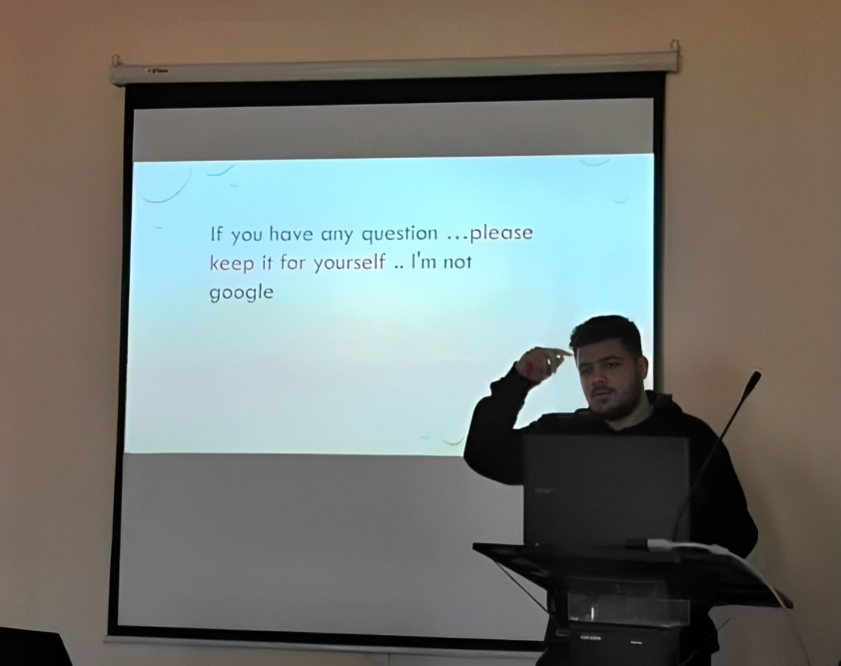

Slide 9
Thank you .

